Slide 1
Heaps
Data Structures and Algorithms
Nanjing University, Fall 2024
郑朝栋

Slide 2
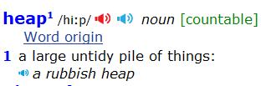
“Heap” as a data structure
In dictionary:
In computer science, a heap is a data structure that is used to represent a collection of “somewhat organized” items.
In fact, the word has other meanings in computer science…

Slide 3
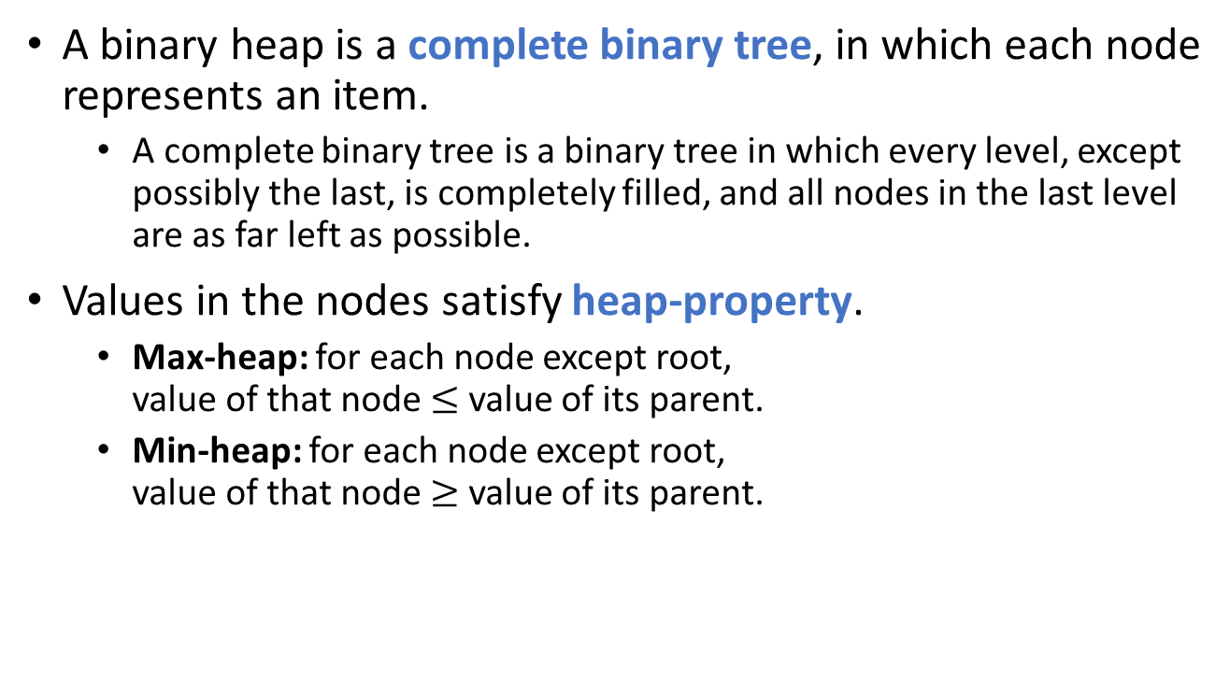
Data structure Binary Heap
A binary heap is a complete binary tree, in which each node represents an item.
A complete binary tree is a binary tree in which every level, except possibly the last, is completely filled, and all nodes in the last level are as far left as possible.
Values in the nodes satisfy heap-property.
Max-heap: for each node except root, value of that node $≤$ value of its parent.
Min-heap: for each node except root, value of that node $≥$ value of its parent.
16
14
10
8
7
9
3
2
4
1

Slide 4
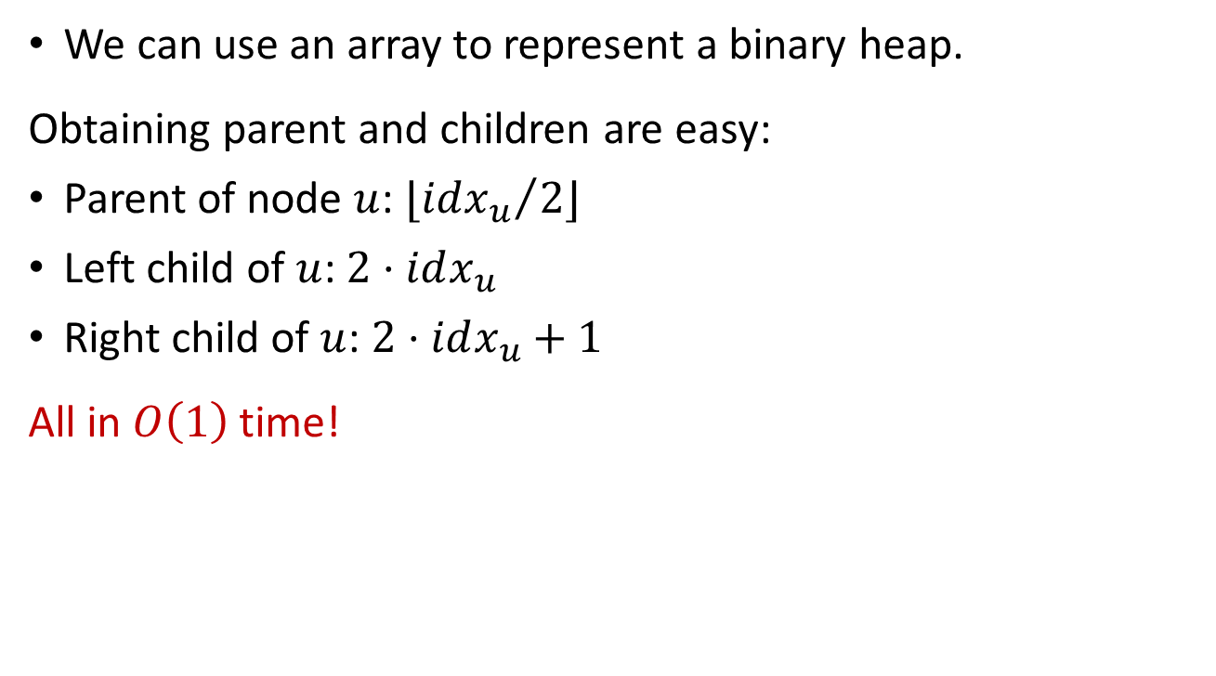
Data structure Binary Heap
We can use an array to represent a binary heap.
Obtaining parent and children are easy:
Parent of node $u$: $⌊{idx_{u}}/2⌋$
Left child of $u$: $2⋅idx_{u}$
Right child of $u$: $2⋅idx_{u}+1$
All in $O\left(1\right)$ time!
1
16
2
3
14
10
4
5
6
7
8
7
9
3
8
2
9
4
10
1
1
2
3
4
5
6
7
8
9
10
16
14
10
8
7
9
3
2
4
1

Slide 5

Common operations of Binary Max-Heap
Consider max-heap as an example. (Min-heap is similar.)
Most common operations:
HeapInsert: insert an element into the heap.
HeapGetMax: return the item with maximum value.
HeapExtractMax: remove the item with maximum value from the heap and return it.
Other operations (which we’ll see later)…
Runtime is $O\left(1\right)$

Slide 6
Operations of binary max-heap HeapInsert
Insert an item into a binary max-heap represented by an array.
Simply put the item to the end of the array.
We need to maintain heap property after insertion: along the path to root, compare and swap. (Why?)
1
16
2
3
14
10
4
5
6
7
8
7
9
3
8
2
9
4
10
1
11
15
1
2
3
4
5
6
7
8
9
10
11
16
14
10
8
7
9
3
2
4
1
15
15

Slide 7
Operations of binary max-heap HeapInsert
Insert an item into a binary max-heap represented by an array.
Simply put the item to the end of the array.
We need to maintain heap property after insertion: along the path to root, compare and swap. (Why?)
1
16
2
3
14
10
4
5
6
7
8
15
9
3
8
2
9
4
10
1
11
7
1
2
3
4
5
6
7
8
9
10
11
16
14
10
8
15
9
3
2
4
1
7

Slide 8

Operations of binary max-heap HeapInsert
Insert an item into a binary max-heap represented by an array.
Simply put the item to the end of the array.
We need to maintain heap property after insertion: along the path to root, compare and swap. (Why?)
Runtime is $O(\lg{n})$.
1
16
2
3
15
10
4
5
6
7
8
14
9
3
HeapInsert(x):
heap_size++
data[heap_size] = x
idx = heap_size
while (idx>1 and data[Floor(idx/2)]<data[idx])
Swap(data[Floor(idx/2)], data[idx])
idx = Floor(idx/2)
8
2
9
4
10
1
11
7
1
2
3
4
5
6
7
8
9
10
11
16
15
10
8
14
9
3
2
4
1
7

Slide 9
Operations of binary max-heap HeapExtractMax
Remove the maximum item from the heap and return it.
Remove and return root is simple, but then what to do?!
Move the last item to the root!
Again, we need to maintain the heap property: compare with children, swap with bigger one; do this recursively.
1
1
16
2
3
14
10
4
5
6
7
8
7
9
3
8
2
9
4
10
1
1
2
3
4
5
6
7
8
9
10
1
14
10
7
9
3
2
4
1
16
8

Slide 10
Operations of binary max-heap HeapExtractMax
Remove the maximum item from the heap and return it.
Remove and return root is simple, but then what to do?!
Move the last item to the root!
Again, we need to maintain the heap property: compare with children, swap with bigger one; do this recursively.
1
1
2
3
14
10
4
5
6
7
8
7
9
3
8
2
9
4
1
2
3
4
5
6
7
8
9
1
14
10
8
7
9
3
2
4

Slide 11
Operations of binary max-heap HeapExtractMax
Remove the maximum item from the heap and return it.
Remove and return root is simple, but then what to do?!
Move the last item to the root!
Again, we need to maintain the heap property: compare with children, swap with bigger one; do this recursively.
1
14
2
3
1
10
4
5
6
7
8
7
9
3
8
2
9
4
1
2
3
4
5
6
7
8
9
14
1
10
8
7
9
3
2
4

Slide 12
Operations of binary max-heap HeapExtractMax
Remove the maximum item from the heap and return it.
Remove and return root is simple, but then what to do?!
Move the last item to the root!
Again, we need to maintain the heap property: compare with children, swap with bigger one; do this recursively.
1
14
2
3
8
10
4
5
6
7
1
7
9
3
8
2
9
4
1
2
3
4
5
6
7
8
9
14
8
10
1
7
9
3
2
4

Slide 13
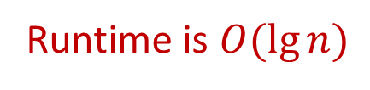
Operations of binary max-heap HeapExtractMax
Remove the maximum item from the heap and return it.
Remove and return root is simple, but then what to do?!
Move the last item to the root!
Again, we need to maintain the heap property: compare with children, swap with bigger one; do this recursively.
HeapExtractMax():
max_item = data[1]
data[1] = data[heap_size--]
MaxHeapify(1)
return max_item
MaxHeapify(idx):
idx_l = 2*i, idx_r = 2*i+1
idx_max = (idx_l<=heap_size && data[idx_l]>data[idx])?
idx_l:idx
idx_max = (idx_r<=heap_size && data[idx_r]>data[idx_max])?
idx_r:idx_max
if (idx_max != idx)
Swap(data[idx_max], data[idx])
MaxHeapify(idx_max)
Runtime is $O(\lg{n})$
1
14
2
3
8
10
4
5
6
7
4
7
9
3
8
2
9
1
1
2
3
4
5
6
7
8
9
14
8
10
4
7
9
3
2
1

Slide 14
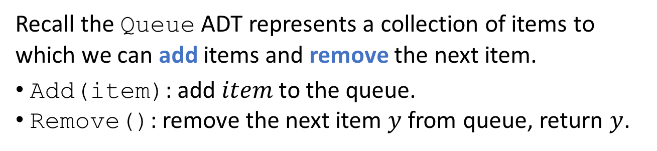
Applications of heaps Priority Queue
Recall the Queue ADT represents a collection of items to which we can add items and remove the next item.
Add(item): add $item$ to the queue.
Remove(): remove the next item $y$ from queue, return $y$.
The queuing discipline decides which item to be removed.
First-in-first-out queue (FIFO Queue)
Last-in-first-out queue (LIFO Queue, Stack)
Priority queue: each item associated with a priority, Remove always deletes the item with max (or min) priority.

Slide 15
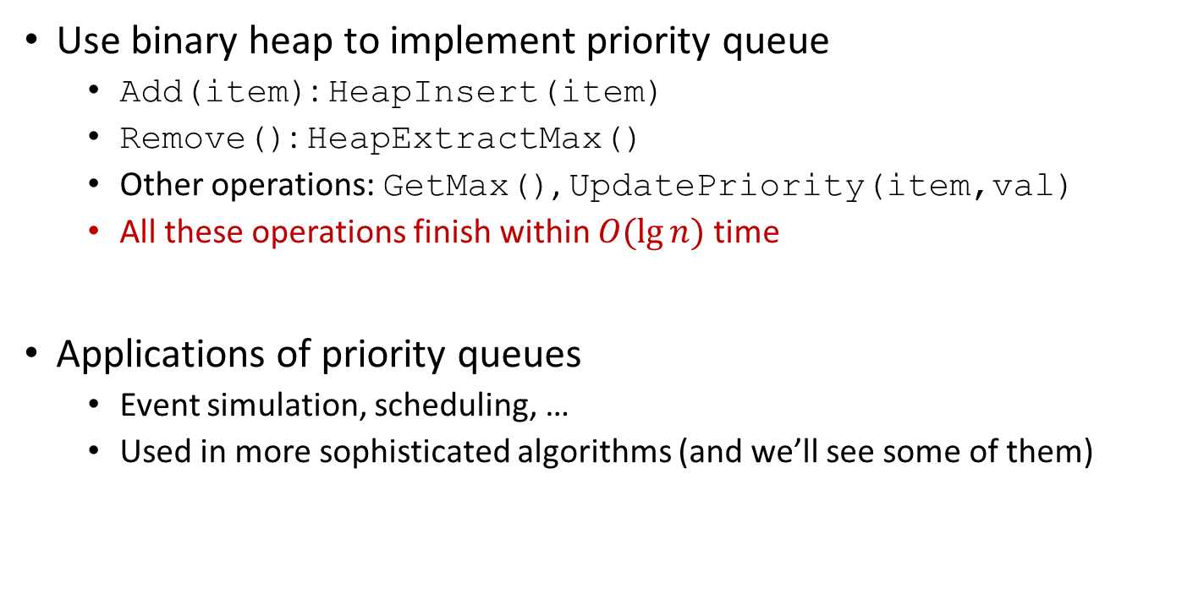
Applications of heaps Priority Queue
Use binary heap to implement priority queue
Add(item): HeapInsert(item)
Remove(): HeapExtractMax()
Other operations: GetMax(), UpdatePriority(item,val)
All these operations finish within $O(\lg{n})$ time
Applications of priority queues
Event simulation, scheduling, …
Used in more sophisticated algorithms (and we’ll see some of them)

Slide 16
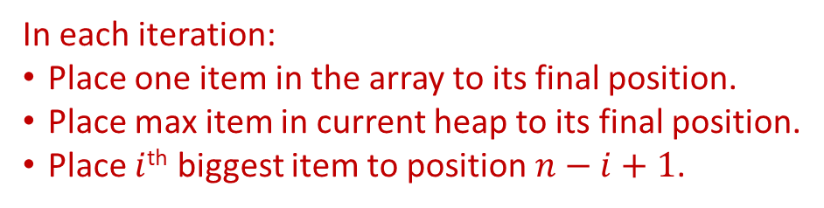
Applications of heaps HeapSort
HeapSort(data[1…n]):
heap = BuildMaxHeap(data[1…n])
for i=n down to 2
cur_max = heap.HeapExtractMax()
data[i] = cur_max
1
14
2
3
8
10
4
5
6
1
7
9
Take an array and make it a max-heap.
1. Keep a copy of the root item
2. Remove last item and put it to root
3. Maintain heap property
4. Return the copy of the root item
8
1
9
14
7
10
1
2
3
4
5
6
14
8
10
1
7
9
In each iteration:
Place one item in the array to its final position.
Place max item in current heap to its final position.
Place $i$^{th} biggest item to position $n−i+1$.

Slide 17

Applications of heaps HeapSort
HeapSort(data[1…n]):
heap = BuildMaxHeap(data[1…n])
for i=n down to 2
cur_max = heap.HeapExtractMax()
data[i] = cur_max
1
9
14
2
3
8
10
4
5
6
1
7
9
1. Keep a copy of the root item
2. Remove last item and put it to root
3. Maintain heap property
4. Return the copy of the root item
$$i=6$$
1
2
3
4
5
6
9
8
10
7
9
14
1
In each iteration:
Place one item in the array to its final position.
Place max item in current heap to its final position.
Place $i$^{th} biggest item to position $n−i+1$.
14

Slide 18
Applications of heaps HeapSort
HeapSort(data[1…n]):
heap = BuildMaxHeap(data[1…n])
for i=n down to 2
cur_max = heap.HeapExtractMax()
data[i] = cur_max
1
10
2
3
8
9
4
5
1
7
1. Keep a copy of the root item
2. Remove last item and put it to root
3. Maintain heap property
4. Return the copy of the root item
$$i=6$$
1
2
3
4
5
6
9
14
10
8
1
7
9
In each iteration:
Place one item in the array to its final position.
Place max item in current heap to its final position.
Place $i$^{th} biggest item to position $n−i+1$.
14

Slide 19

Applications of heaps HeapSort
HeapSort(data[1…n]):
heap = BuildMaxHeap(data[1…n])
for i=n down to 2
cur_max = heap.HeapExtractMax()
data[i] = cur_max
1
7
10
2
3
8
9
4
5
1
7
1. Keep a copy of the root item
2. Remove last item and put it to root
3. Maintain heap property
4. Return the copy of the root item
$$i=5$$
1
2
3
4
5
6
7
8
9
7
14
10
1
In each iteration:
Place one item in the array to its final position.
Place max item in current heap to its final position.
Place $i$^{th} biggest item to position $n−i+1$.
10

Slide 20
Applications of heaps HeapSort
HeapSort(data[1…n]):
heap = BuildMaxHeap(data[1…n])
for i=n down to 2
cur_max = heap.HeapExtractMax()
data[i] = cur_max
1
9
2
3
8
7
4
1
1. Keep a copy of the root item
2. Remove last item and put it to root
3. Maintain heap property
4. Return the copy of the root item
$$i=5$$
1
2
3
4
5
6
8
7
10
14
9
1
7
In each iteration:
Place one item in the array to its final position.
Place max item in current heap to its final position.
Place $i$^{th} biggest item to position $n−i+1$.
10

Slide 21

Applications of heaps HeapSort
HeapSort(data[1…n]):
heap = BuildMaxHeap(data[1…n])
for i=n down to 2
cur_max = heap.HeapExtractMax()
data[i] = cur_max
1
1
9
2
3
8
7
4
1
1. Keep a copy of the root item
2. Remove last item and put it to root
3. Maintain heap property
4. Return the copy of the root item
$$i=4$$
1
2
3
4
5
6
9
8
7
1
10
14
1
In each iteration:
Place one item in the array to its final position.
Place max item in current heap to its final position.
Place $i$^{th} biggest item to position $n−i+1$.
9

Slide 22
Applications of heaps HeapSort
HeapSort(data[1…n]):
heap = BuildMaxHeap(data[1…n])
for i=n down to 2
cur_max = heap.HeapExtractMax()
data[i] = cur_max
1
8
2
3
1
7
1. Keep a copy of the root item
2. Remove last item and put it to root
3. Maintain heap property
4. Return the copy of the root item
$$i=4$$
1
2
3
4
5
6
8
1
7
9
10
14
1
In each iteration:
Place one item in the array to its final position.
Place max item in current heap to its final position.
Place $i$^{th} biggest item to position $n−i+1$.
9

Slide 23

Applications of heaps HeapSort
HeapSort(data[1…n]):
heap = BuildMaxHeap(data[1…n])
for i=n down to 2
cur_max = heap.HeapExtractMax()
data[i] = cur_max
1
8
7
2
3
1
7
1. Keep a copy of the root item
2. Remove last item and put it to root
3. Maintain heap property
4. Return the copy of the root item
$$i=3$$
1
2
3
4
5
6
8
8
1
7
9
10
14
7
In each iteration:
Place one item in the array to its final position.
Place max item in current heap to its final position.
Place $i$^{th} biggest item to position $n−i+1$.
8

Slide 24

Applications of heaps HeapSort
HeapSort(data[1…n]):
heap = BuildMaxHeap(data[1…n])
for i=n down to 2
cur_max = heap.HeapExtractMax()
data[i] = cur_max
1
7
1
2
1
1. Keep a copy of the root item
2. Remove last item and put it to root
3. Maintain heap property
4. Return the copy of the root item
$$i=2$$
1
2
3
4
5
6
1
7
8
14
7
1
9
10
In each iteration:
Place one item in the array to its final position.
Place max item in current heap to its final position.
Place $i$^{th} biggest item to position $n−i+1$.
7

Slide 25
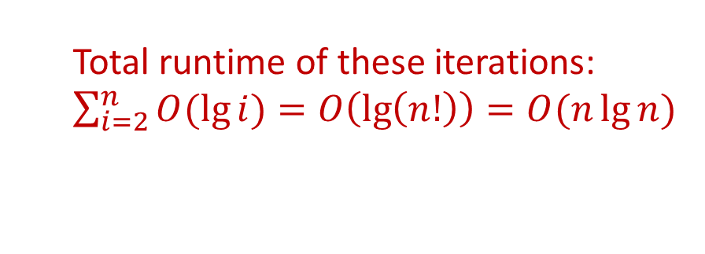
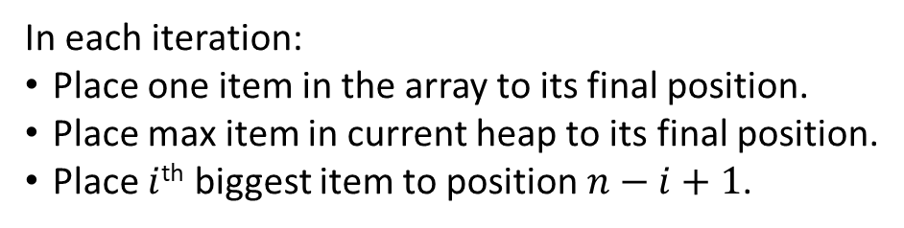
Applications of heaps HeapSort
???
HeapSort(data[1…n]):
heap = BuildMaxHeap(data[1…n])
for i=n down to 2
cur_max = heap.HeapExtractMax()
data[i] = cur_max
In each iteration:
Place one item in the array to its final position.
Place max item in current heap to its final position.
Place $i$^{th} biggest item to position $n−i+1$.
Total runtime of these iterations:
$\sum_{i=2}^{n}{O(\lg{i})}=O\left(\lg\left(n!\right)\right)=O(n\lg{n})$

Slide 26

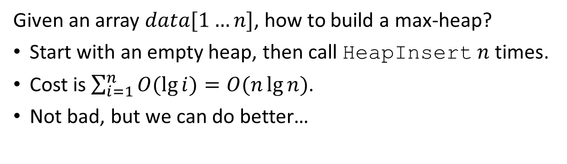
Applications of heaps HeapSort
HeapSort(data[1…n]):
heap = BuildMaxHeap(data[1…n])
for i=n down to 2
cur_max = heap.HeapExtractMax()
data[i] = cur_max
Runtime of for-loop is $O(n\lg{n})$.
Given an array $data[1…n]$, how to build a max-heap?
Start with an empty heap, then call HeapInsert $n$ times.
Cost is $\sum_{i=1}^{n}{O(\lg{i})}=O(n\lg{n})$.
Not bad, but we can do better…

Slide 27
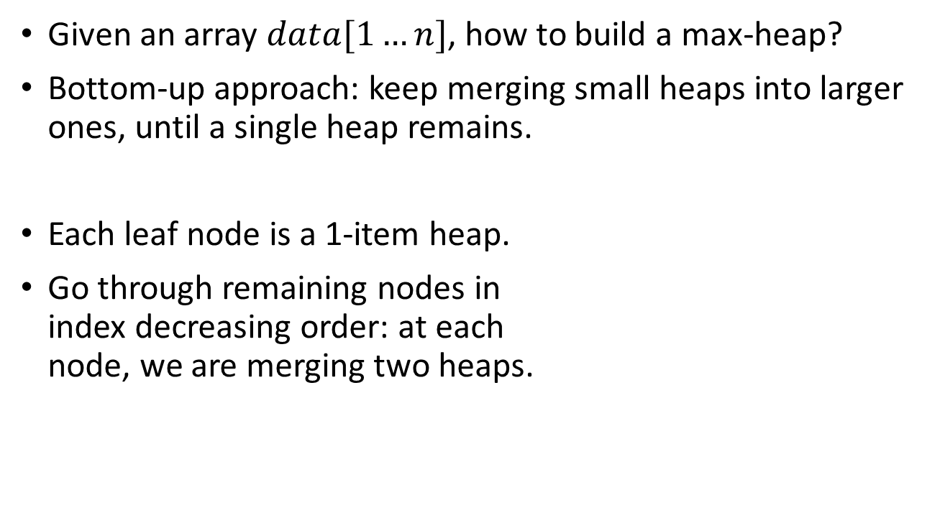
Applications of heaps HeapSort
Given an array $data[1…n]$, how to build a max-heap?
Bottom-up approach: keep merging small heaps into larger ones, until a single heap remains.
Each leaf node is a 1-item heap.
Go through remaining nodes in index decreasing order: at each node, we are merging two heaps.
1
8
2
3
1
9
4
5
6
7
14
7
10
2
1
2
3
4
5
6
7
8
1
9
14
7
10
2

Slide 28
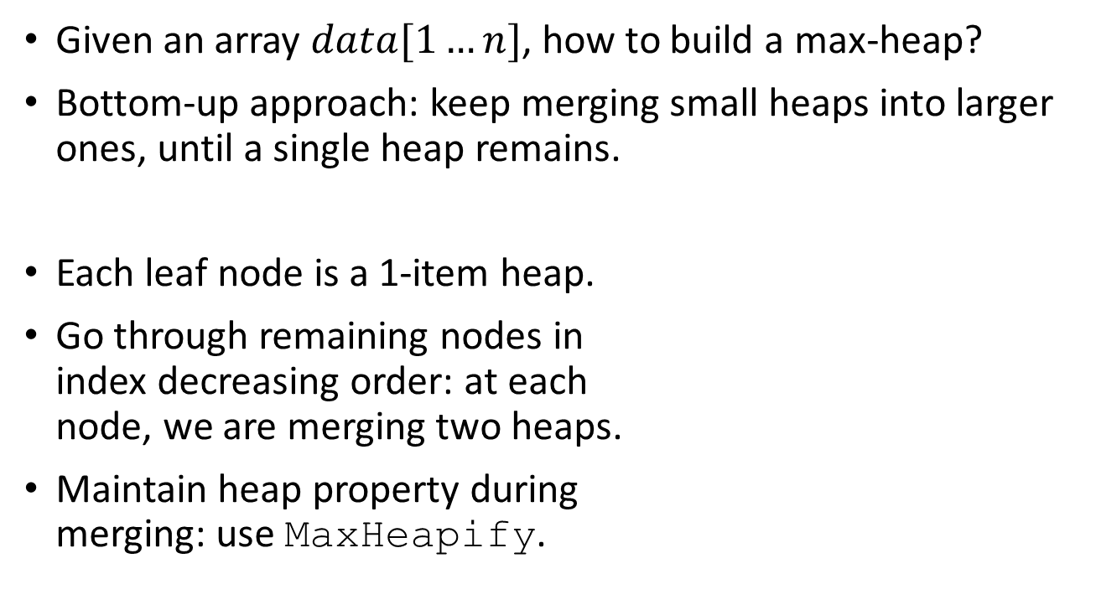
Applications of heaps HeapSort
Given an array $data[1…n]$, how to build a max-heap?
Bottom-up approach: keep merging small heaps into larger ones, until a single heap remains.
Each leaf node is a 1-item heap.
Go through remaining nodes in index decreasing order: at each node, we are merging two heaps.
Maintain heap property during merging: use MaxHeapify.
1
8
2
3
1
9
4
5
6
7
14
7
10
2
1
2
3
4
5
6
7
8
1
9
14
7
10
2

Slide 29
Applications of heaps HeapSort
Given an array $data[1…n]$, how to build a max-heap?
Bottom-up approach: keep merging small heaps into larger ones, until a single heap remains.
Each leaf node is a 1-item heap.
Go through remaining nodes in index decreasing order: at each node, we are merging two heaps.
Maintain heap property during merging: use MaxHeapify.
1
8
2
3
1
10
4
5
6
7
14
7
9
2
1
2
3
4
5
6
7
8
1
10
14
7
9
2

Slide 30
Applications of heaps HeapSort
Given an array $data[1…n]$, how to build a max-heap?
Bottom-up approach: keep merging small heaps into larger ones, until a single heap remains.
Each leaf node is a 1-item heap.
Go through remaining nodes in index decreasing order: at each node, we are merging two heaps.
Maintain heap property during merging: use MaxHeapify.
1
8
2
3
14
10
4
5
6
7
1
7
9
2
1
2
3
4
5
6
7
8
14
10
1
7
9
2

Slide 31
Applications of heaps HeapSort
BuildMaxHeap(data[1…n]):
heap_size = n
for i=Floor(n/2) down to 1
MaxHeapify(i)
Given an array $data[1…n]$, how to build a max-heap?
Bottom-up approach: keep merging small heaps into larger ones, until a single heap remains.
Each leaf node is a 1-item heap.
Go through remaining nodes in index decreasing order: at each node, we are merging two heaps.
Maintain heap property during merging: use MaxHeapify.
1
14
2
3
8
10
4
5
6
7
1
7
9
2
1
2
3
4
5
6
7
14
8
10
1
7
9
2

Slide 32
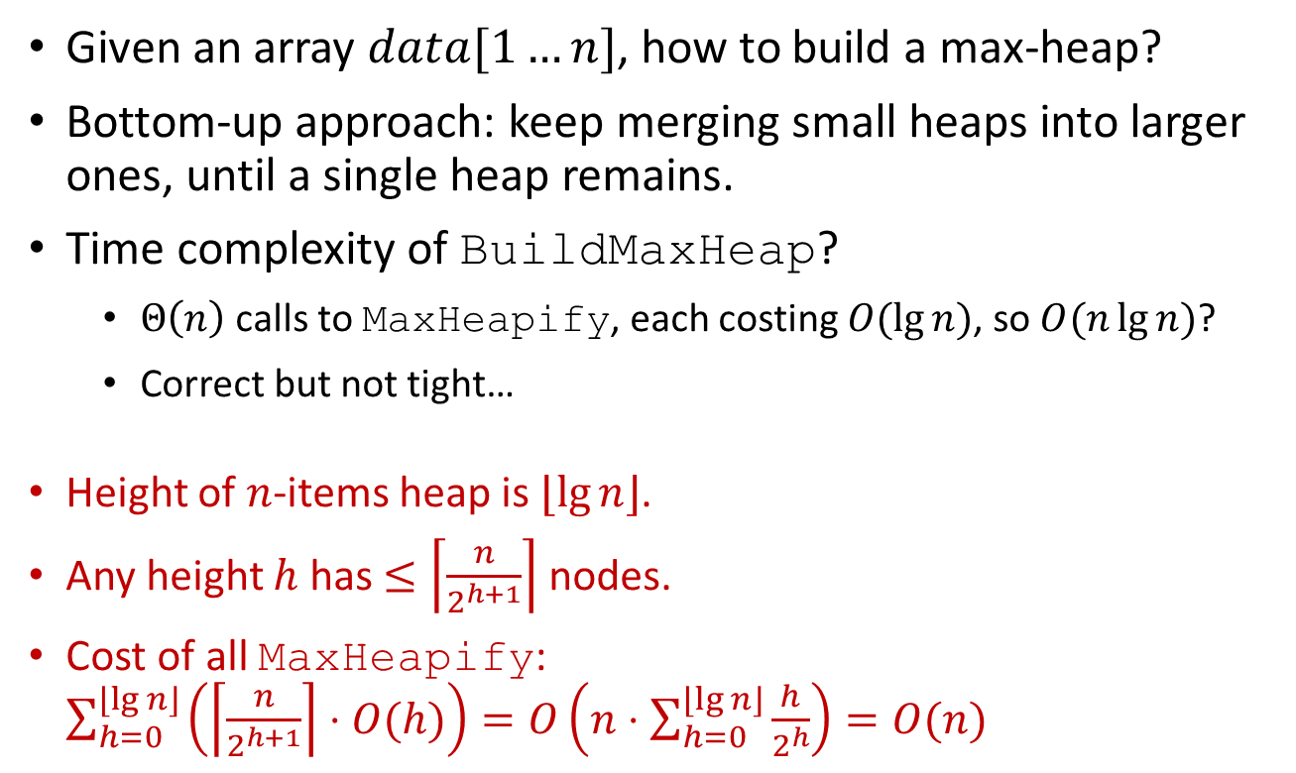
Applications of heaps HeapSort
BuildMaxHeap(data[1…n]):
heap_size = n
for i=Floor(n/2) down to 1
MaxHeapify(i)
Given an array $data[1…n]$, how to build a max-heap?
Bottom-up approach: keep merging small heaps into larger ones, until a single heap remains.
Time complexity of BuildMaxHeap?
$Θ\left(n\right)$ calls to MaxHeapify, each costing $O(\lg{n})$, so $O(n\lg{n})$?
Correct but not tight…
Height of $n$-items heap is $⌊\lg{n}⌋$.
Any height $h$ has $≤\left\lceil \frac{n}{2^{h+1}}\right\rceil$ nodes.
Cost of all MaxHeapify: $\sum_{h=0}^{⌊\lg{n}⌋}{\left(\left\lceil \frac{n}{2^{h+1}}\right\rceil ⋅O(h)\right)}=O\left(n⋅\sum_{h=0}^{⌊\lg{n}⌋}{\frac{h}{2^{h}}}\right)=O(n)$
1
8
2
3
1
9
4
5
6
7
14
7
10
2

Slide 33


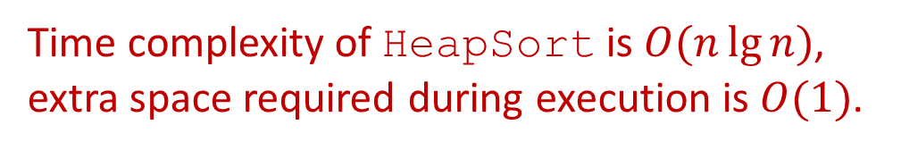
Applications of heaps HeapSort
BuildMaxHeap(data[1…n]):
heap_size = n
for i=Floor(n/2) down to 1
MaxHeapify(i)
Runtime of BuildMaxHeap is $O(n)$.
HeapSort(data[1…n]):
heap = BuildMaxHeap(data[1…n])
for i=n down to 2
cur_max = heap.HeapExtractMax()
data[i] = cur_max
Runtime of for-loop is $O(n\lg{n})$.
Time complexity of HeapSort is $O(n\lg{n})$, extra space required during execution is $O(1)$.

Slide 34
Reading
[CLRS] Ch.6

